Slide 1
Computer Simulation and Modeling
Fractals

Slide 2
What are Fractals?
A curve or geometrical figure, each part of which has the same statistical character as the whole
Mathematical expressions to generate pretty pictures
Evaluate math functions to create drawings
approach infinity ‐> converge to image
Utilizes recursion on computers
Dimensional:
Line is 1‐dimensional
Plane is 2‐dimensional
Defined in terms of self‐similarity

Slide 3
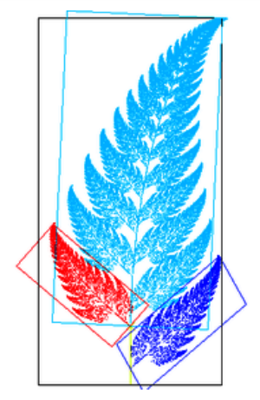
Fractals: Self‐similarity
See similar sub‐images within image as we zoom in
Example: surface roughness or profile same
as we zoom in
Types:
Exactly self‐similar
Statistically self‐similar

Slide 4
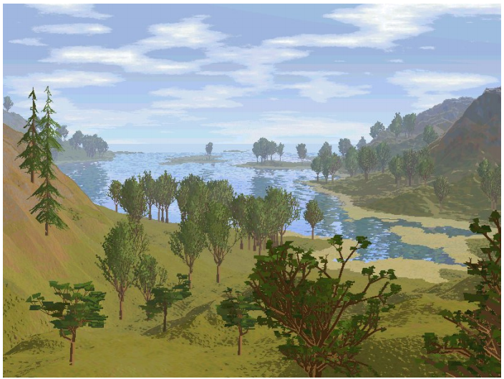
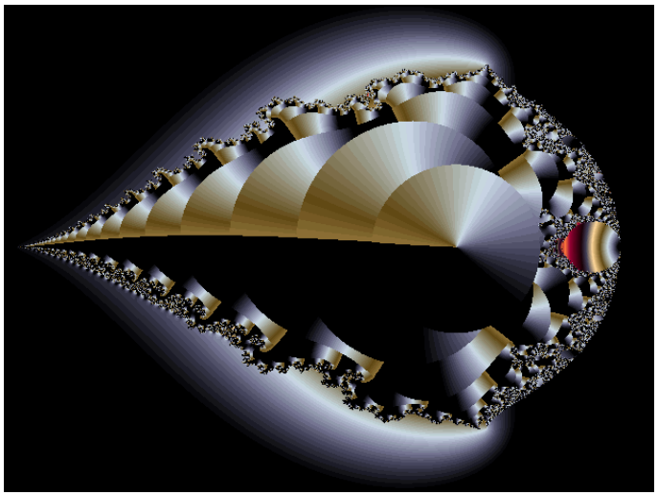
Examples of Fractals
Clouds
Grass
Fire
Modeling mountains (terrain)
Coastline
Branches of a tree
Surface of a sponge
Cracks in the pavement

Slide 5
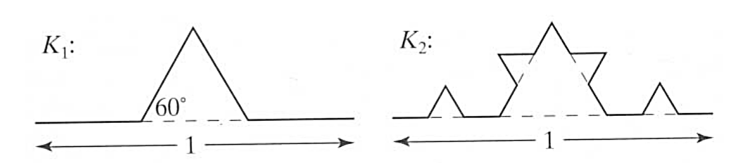
Koch Curves
Start with straight line of length 1
Recursively:
Divide line into 3 equal parts
Replace middle section with triangular bump, sides of length 1/3
New length = 4/3

Slide 6
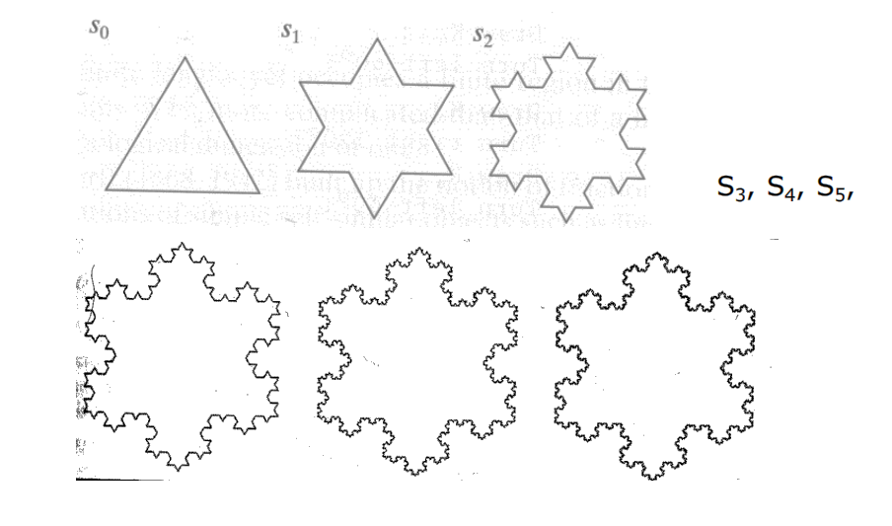
Koch Curves
Can form Koch snowflake by joining three Koch curves

Slide 7
Fractal Dimensions
1D line of unit length divided into n segments looks like the whole line scaled by 1/n
2D square of unit area divided into n segments looks like the whole square scaled by 1/n^{1/2}
Divide an object into n segments where each segment is scaled by 1/s
s = n^{1/d} d = log(n)/log(s) 2 = log(4)/log(2)
The square is divided into 4 parts and each segment of each part is 1/2 the size of the original
d = log(4)/log(2) = 2

Slide 8
Fractal Dimensions
s = n^{1/d} d = log(n)/log(s)
Koch curve divides line into 4 parts, each part is 1/3 the size of the original
Therefore the dimension of the Koch curve is:
4^{1/d} = 3, n^{1/d} = s
d = log(4)/log(3) = log(n)/log(s) =1.26186……

Slide 9
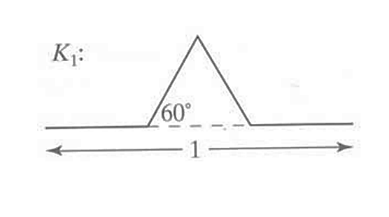
Koch Snowflakes
Pseudocode, to draw K_{n}:
if (n equals 0) draw straight line
else{
Draw K_{n-1}
Turn left 60°
Draw K_{n-1}
Turn right 120°
Draw K_{n-1}
Turn left 60°
Draw K_{n-1}
}

Slide 10
L‐Systems: Lindenmayer Systems
Express complex curves as simple set of string‐production rules
Example rules:
‘F’: go forward a distance 1 in current direction
‘+’: turn right through angle A degrees
‘‐’: turn left through angle A degrees
Using these rules, can express koch curve as: “F‐F++F‐F”
Angle A = 60 degrees

Slide 11
L‐Systems: Koch Curves
Rule for Koch curves is F ‐> F‐F++F‐F
Means each iteration replaces every ‘F’ occurrence with “F‐F++F‐F”
S₀, if initial string (called the atom) is ‘F’, then
S₁ =“F‐F++F‐F”
S₂ =“F‐F++F‐F‐ F‐F++F‐F++ F‐F++F‐F‐ F‐F++F‐F”

Slide 12
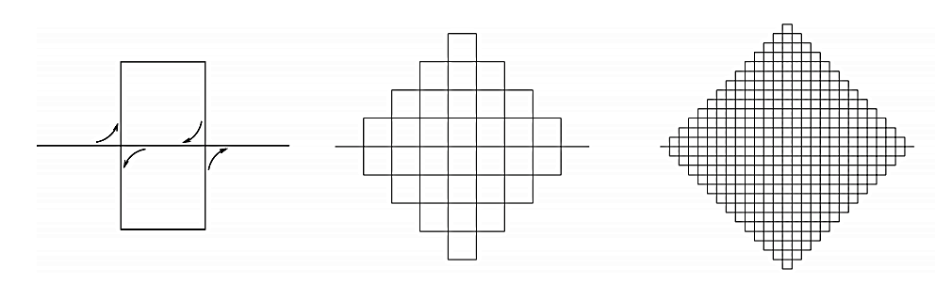
Space Filling Fractals
Peano Curve
Fills a 2D region
Fractal dimension = 2
s = n^{1/d} 9 segments 1/3 original size
2 = log(9)/log(3)

Slide 13
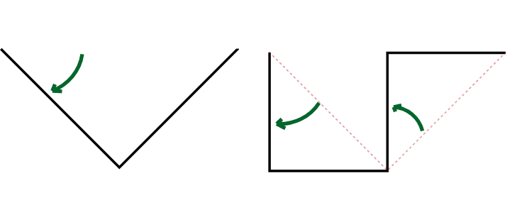
Dragon Curve
starting from a base segment
replace each segment by 2 segments with a right angle
a rotation of 45° alternatively to the right and to the left

Slide 14
Dimension of Dragon Curve
s = n^{1/d} 2 segments 1/√2 original size
d = log(2)/log(√2) = 2
That makes it a space-filling curve.

Slide 15

Pythagoras Tree
String Production Rules:
0 → 1 [ 0 ] 0 Atom: 0
1 → 1 1
0 = Draw a line segment and stay at the end terminal
1 = Draw a line segment
[ = Push current state (position and angle), then turn left 45°
] = Pop the last saved state (position and angle),
then turn right 45°

